Slide 1

Generating Random Numbers (OTP, keys)
Kajal Patel
RA – Idrbt hyderabad

Slide 2
Overview
What are Random Numbers and where we use it
Generating Random numbers for OTPs, Passwords and keys
Application demo

Slide 3
We use Random numbers to create OTP’s, Passwords & Keys
Passwords: When creating a password, you want it to be hard for others to guess. Random numbers mixed with other characters make a strong password. For example, a password like "P@ssw0rd123" is stronger than "password123" because it's more complex.
OTPs (One-Time Passwords): An OTP is a code that you use only once, usually for logging into a secure account. It adds an extra layer of security. For example, when you receive a code on your phone to enter while logging in, that's an OTP.
Keys: Generating random numbers for keys ensures that each encryption is unique

Slide 4
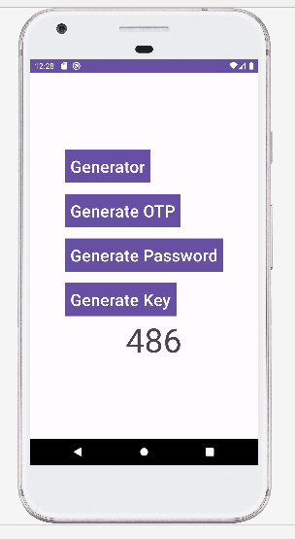
This is the UI of the application, Where we have 4 buttons and 1 TextView

Slide 5
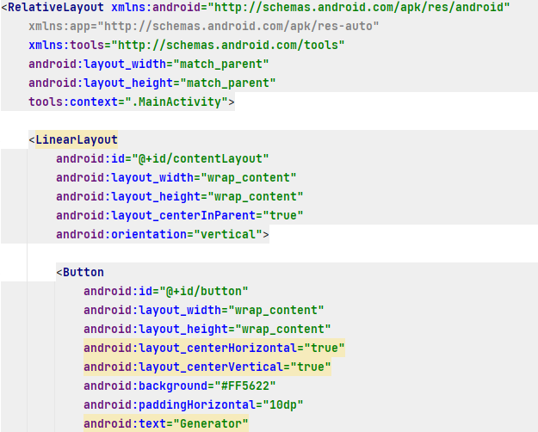
RelativeLayout – It is a view group that dispalys child views in relative positions
LinearLayout is a view group that aligns all children in a single direction, vertically or horizontally
Here we are creating button to generate Random numbers

Slide 6
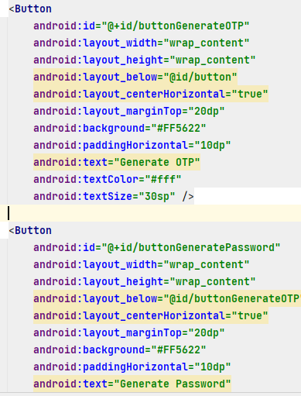
Here we are creating Generate OTP Button
Here we are creating Generate Password Button

Slide 7
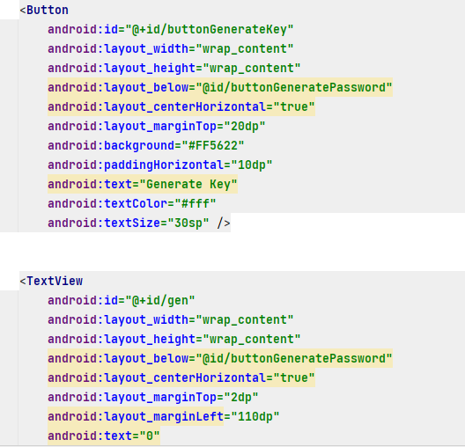
Here we are creating Generate Key Button
Here we are creating Generate TextView

Slide 8
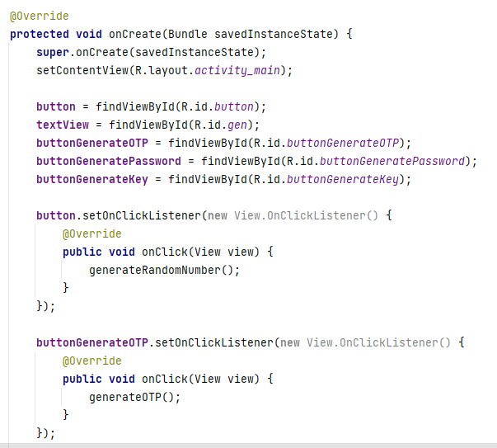
First have to call all Buttons and TextView through ID in MainActivity.java file and have to declare onClickListener method

Slide 9
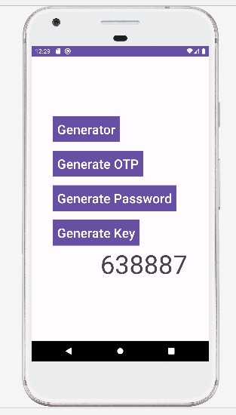
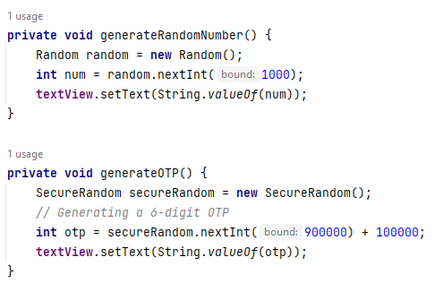
On click of the button Generate OTP1st it will onClickListener on listener will have method called onClick() where it calls generateOTP() method

Slide 10
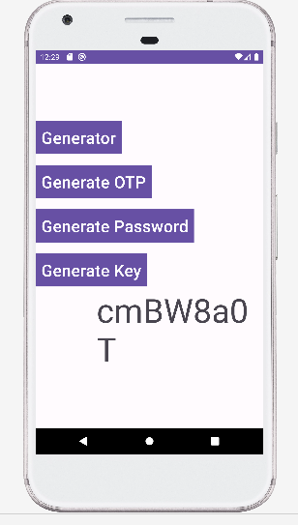
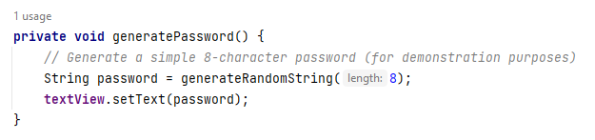
On click of the button Generate password 1st it will onClickListener on listener will have method called onClick() where it calls generatePassword() method

Slide 11
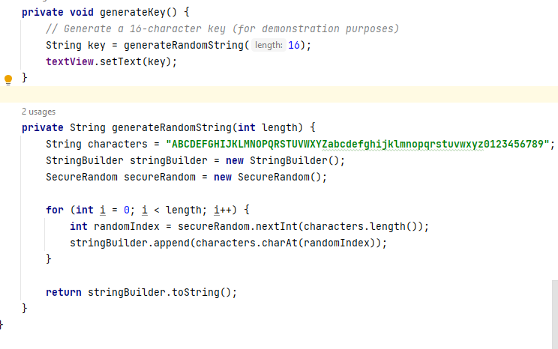
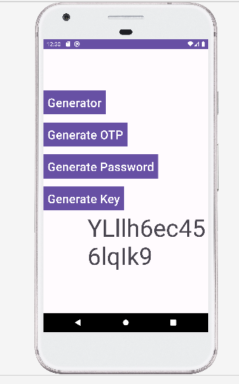

Slide 12
THANK YOU

